Slide 1
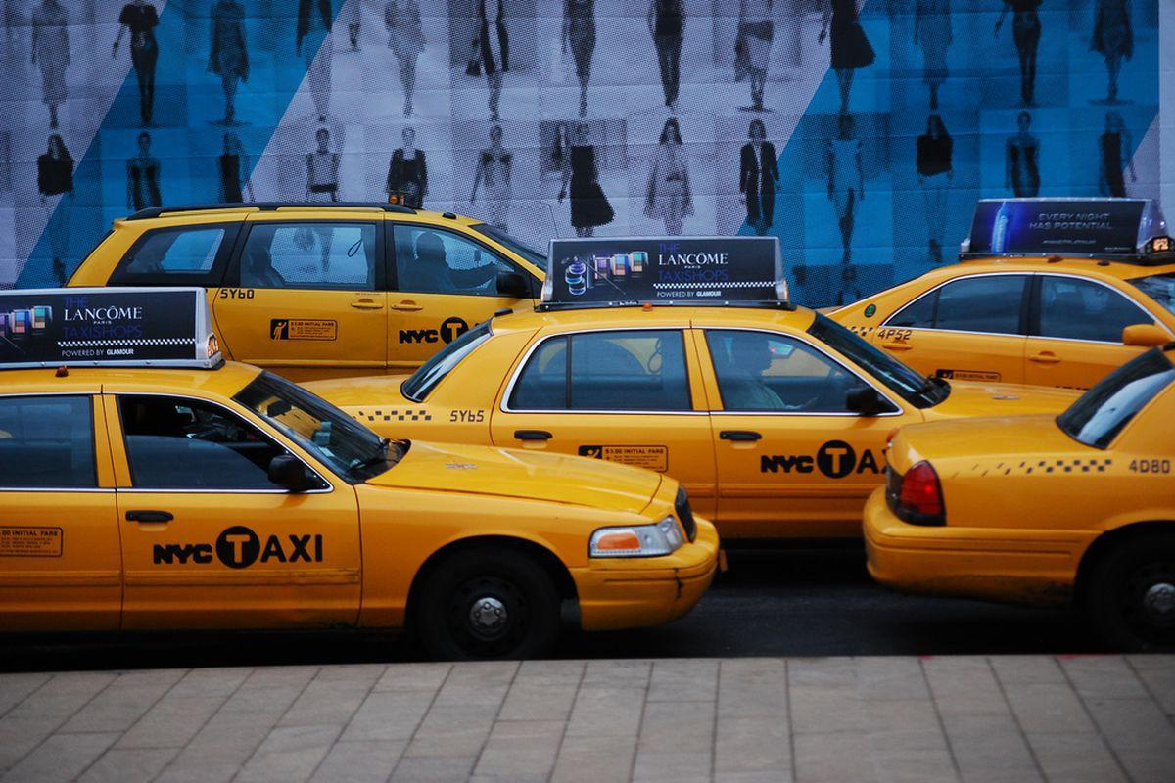
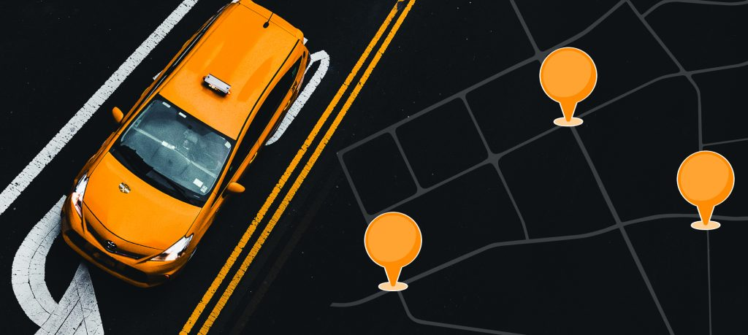
Taxi Demand Prediction- New York City
Team Member :
Chitranshu Gupta
Ankush Kumar
Baibhav Tripathi

Slide 2
Problem Definition
For a given location in New York City, our goal is to predict the number of pickups in that given location at particular time interval. Some location require more taxis at a particular time than other locations owing to the presence schools, hospitals, offices etc. The prediction result can be transferred to the taxi drivers, and they can subsequently move to the locations where predicted pickups are high.

Slide 3
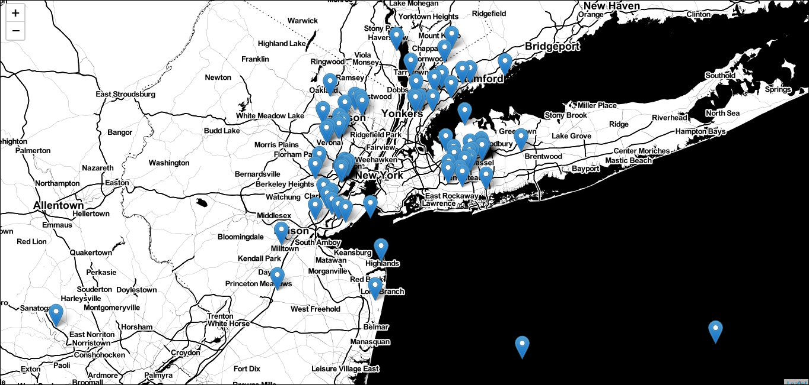

Slide 4
Objectives & Constraints
Objectives:
Our objective is to predict the number of pickups as accurately as possible for each region in a 10 min interval. We will break up the whole New York City into regions, that we will discuss later in the blog. Now, the 10 min interval is chosen because in NYC one can commute 1 mile in approximately 10 minutes given the traffic is normal at that particular time.

Slide 5
Constraints:
Latency: Given a location and current time of a taxi driver, as a taxi driver, he/she excepts to get the predicted pickups in his/her region and the adjoining regions in few seconds. Hence, there is a medium latency requirement.
Interpretability: As long as taxi driver gets good prediction result, he/she is not be much interested in the interpretability of the result. He/she is not much interested in why he/she is getting this result. Hence, there is a no interpretability required.

Slide 6
Relative Errors: Mean Absolute Percentage Error will be the relative error we will consider. Let say the predicted pickups for a particular location are 100, but actual pickups are 102, the percentage error will be 2% and Absolute error is 2. The taxi driver will be more interested in the percentage error than the absolute error. Let say in some region the predicted pickups are 250, and if taxi driver knows that the relative error is 10% then he/she will consider the predicted result to be in the range of 225 to 275, which is considerable.
Our goal is to reduce the percentage error as low as possible.

Slide 7
Proposed System architecture
Software and Hardware requirements
Implementation Details
Python3 – code
Machine Learning
Data Analysis
System Specifications
CPU – Intel Core i7/i5 3.60 Ghz
RAM – 4/8 Gb GPU – Nvidia/AMD/Intel Integrated
Google Cloud

Slide 8
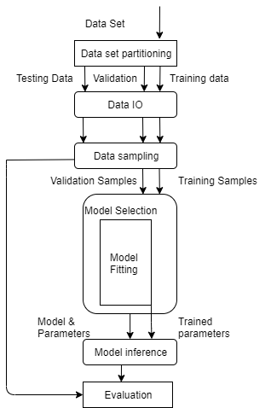
Process Diagram

Slide 9
Algorithms:
Linear Regression.
Random Forest Regressor.
XGBoost Regressor.
Model Comparison.

Slide 10
Thank you….

